Slide 1
Step 3: Data Exploration and Understanding
CSE475 - Foundations of Machine Learning
Part 1 - Machine Learning Basics
Dr. Robert Atkinson

Slide 2
Step 2: Data Collection
Lecture Dataset (In-Class Example): Palmer Penguins Dataset
Why: It’s a small, clean dataset with a balance of numerical and categorical features, ideal for introducing concepts like data exploration, univariate and bivariate analysis.
Purpose: Suitable for live demonstrations during lectures.
Features: Species, island, bill length, bill depth, flipper length, body mass, sex, etc.
In-Class Activity Dataset: Iris Dataset
Why: It’s a classic dataset used for beginner-level machine learning, with fewer features and a balanced number of classes, ideal for practicing EDA and basic classification.
Purpose: Perfect for hands-on practice in bivariate analysis (scatter plots, correlation) and summary statistics.
Features: Sepal length, sepal width, petal length, petal width, species (classification target).

Slide 3
Step 2: Data Collection
Take-Home Assignment Dataset: Titanic Dataset
Why: It’s a more complex dataset with missing values, a mix of categorical and numerical data, and plenty of opportunities to apply advanced EDA techniques.
Purpose: Ideal for take-home assignments, where students can dive deeper into data cleaning, visualization, and basic model building.
Features: Passenger class, age, fare, embarked, survived (target), gender, etc.

Slide 4
Approaching ML Syntax vs. Algorithm-Heavy Programming: A Practical Guide

Slide 5
Focus on Model Application, Not Algorithmic Details
Goal: Understand how to use pre-built models effectively without worrying about how the algorithms are implemented.
How: Instead of focusing on how algorithms like decision trees or support vector machines work internally, focus on:
How to select and apply models using high-level libraries like scikit-learn.
How to interpret model outputs like accuracy, precision, and confusion matrices.
Example: Instead of focusing on how a support vector machine mathematically creates decision boundaries, learn how to:
Apply the support vector machine with simple syntax.
Evaluate its performance using metrics like accuracy or precision.
Why: In real-world applications, the ability to apply and understand models is more valuable than understanding the inner workings of each algorithm.

Slide 6
Practicality Over Efficiency
Goal: Focus on applying models to real-world problems quickly, rather than optimizing algorithms.
How: Learn to use pre-built functions that are optimized for you, and focus on getting results. Experiment with different models and hyperparameters, but don’t worry about manual optimization.
Example: Instead of worrying about optimizing how k-nearest neighbors runs, focus on:
How to use k-nearest neighbors to classify data.
How to compare different models quickly to see which performs best for your dataset.
Why: In industry, speed and practicality are key. Being able to apply models efficiently matters more than writing and optimizing algorithms yourself.

Slide 7
Emphasize Iteration and Experimentation
Goal: Quickly experiment with different models and hyperparameters.
How: Use tools like GridSearchCV to easily test multiple models and hyperparameters, and focus on seeing the impact of different configurations.
Example: Use grid search to find the best hyperparameters:
Try different combinations of hyperparameters and models.
Observe how each model performs without needing to manually implement or optimize them.
Why: Machine learning often involves testing and improving models. Experimenting with different options helps you learn faster.

Slide 8
Focus on the Entire ML Workflow
Goal: Master the full workflow from preprocessing data to evaluating and deploying models.
How: Instead of focusing on how algorithms work, focus on the workflow: data preprocessing, model selection, training, evaluation, and improvement.
Example: Learn how to:
Preprocess data (e.g., handling missing values, scaling features) to improve model performance.
Interpret results using confusion matrices and classification reports to understand model accuracy.
Why: In practical machine learning, applying models and interpreting results are critical. Mastering the workflow ensures you’re ready to work on real-world projects.

Slide 9
Understand That Algorithms Are Abstracted Away
Goal: Recognize that pre-built functions take care of the algorithmic details for you.
How: When you use functions like fit() or predict(), the library handles all the algorithmic steps. Focus on applying the model rather than writing the algorithm yourself.
Example: Instead of writing a logistic regression algorithm from scratch, learn how to:
Apply logistic regression using a library function.
Evaluate the model’s performance based on outputs like accuracy or AUC score.
Why: This approach allows you to focus on solving problems without getting bogged down in algorithm implementation.

Slide 10
ML Workflow Step 3: Data Exploration and Understanding

Slide 11
Preliminary Setup
Import Libraries: This includes importing essential libraries like pandas, matplotlib, and seaborn for EDA.
# Step 1: Import necessary libraries and load the dataset
import pandas as pd
import seaborn as sns
import matplotlib.pyplot as plt

Slide 12
Loading Data with read_csv()
Load Data: This involves loading the dataset into a Pandas DataFrame (df), whether from a local file (e.g., CSV) or an online source.
Syntax: df = pd.read_csv('file.csv')
Purpose: Reads a CSV file and stores it in a DataFrame (a table-like data structure) called df. You can use this for structured data stored in CSV files.
# Load dataset (example: Titanic dataset)
df = sns.load_dataset('titanic')

Slide 13
Steps for EDA in the Understanding Stage
Overview of Data (Initial Exploration)
Univariate Analysis (Understanding Individual Variables)
Includes identifying Missing Data and Outliers
Bivariate Analysis (Exploring Relationships Between Pairs of Variables)
Multivariate Analysis (Exploring Relationships Among Multiple Variables)

Slide 14
Overview of Data (Initial Exploration)
Goal: Get a broad understanding of the dataset’s structure, dimensions, and content.
Actions: Inspect data types, preview rows, check missing values, and count unique values.
Key Question: What does the dataset look like, and how is it structured?
Descriptive Statistics: Data types, non-null counts, summary statistics for numeric columns (mean, min, max), unique value counts for categorical columns.
Data Visualizations: Typically none (basic inspection using head function).

Slide 15
Univariate Analysis (Understanding Individual Variables)
Goal: Explore the distribution and characteristics of each individual variable.
Actions: Summarize statistics, check for outliers, skewness, and kurtosis, and visualize distributions.
Key Question: What are the key characteristics of each variable?
Descriptive Statistics: Mean, median, mode, standard deviation, min/max values, skewness, kurtosis.
Data Visualizations: Histograms, box plots, bar charts, cumulative plots.

Slide 16
Univariate Concerns
Outliers: Unusual values can distort the analysis or indicate data entry errors.
Skewed Distribution: Highly skewed data may require transformations or special handling for models.
Missing Data: Univariate analysis often reveals missing values, which can affect the integrity of the dataset.
Non-Informative Features: Features with constant values or very little variance may not be useful for analysis and may be removed.

Slide 17
Bivariate Analysis (Exploring Relationships Between Pairs of Variables)
Goal: Examine relationships between two variables to detect patterns and correlations.
Actions: Compute correlations, compare distributions, and visualize relationships.
Key Question: How do two variables relate to each other?
Descriptive Statistics: Correlation coefficients, covariance, group statistics (e.g., mean by category).
Data Visualizations: Scatter plots, box plots, correlation heatmaps, hexbin plots.

Slide 18
Bivariate Concerns
Spurious Correlations: Sometimes variables appear to have a relationship, but it may be due to random chance or hidden factors.
Confounding Variables: Relationships between two variables may be influenced by a third, unconsidered variable.
Non-Linearity: A simple correlation coefficient may not capture non-linear relationships.
Heteroscedasticity: In scatter plots, the variance of the dependent variable can increase or decrease with the independent variable, indicating potential issues with variability across different values

Slide 19
Multivariate Analysis (Exploring Relationships Among Multiple Variables)
Goal: Analyze interactions among multiple variables to uncover complex patterns.
Actions: Visualize relationships between multiple variables, compute correlation matrices.
Key Question: How do multiple variables interact?
Descriptive Statistics: Correlation matrix, multicollinearity checks, interaction effects.
Data Visualizations: Pair plots, 3D scatter plots, facet grids, violin plots, grouped bar plots.

Slide 20
Multivariate Concerns
Multicollinearity: Highly correlated features can cause issues in models like linear regression. We may need to remove or combine variables.
Overfitting: When adding more features, models may become overly complex, capturing noise rather than the underlying pattern.
Dimensionality: High-dimensional data can be difficult to visualize and interpret, leading to the "curse of dimensionality." Techniques like PCA or feature selection can help reduce dimensionality.
Interactions: Without proper exploration, we may miss significant interactions between variables that influence the target.

Slide 21
Common EDA Syntax

Slide 22
Checking the Shape of the DataFrame
Syntax: df.shape
Why: Provides a quick overview of the dataset’s size (rows, columns) and helps ensure it matches expectations.
Use: Essential for verifying data after loading or preprocessing, and for model preparation.
Example output: (150, 5) # 150 rows, 5 columns

Slide 23
Viewing Data Types with info()
Syntax: df.info()
Why: Provides details on the data types of each column, counts of non-null values, and memory usage.
Use: Useful for identifying data types (e.g., numerical, categorical) and detecting missing values.

Slide 24
Example Output
RangeIndex: 150 entries, 0 to 149
Data columns (total 5 columns):
# Column Non-Null Count Dtype
--- ------ -------------- -----
0 col1 150 non-null int64
1 col2 150 non-null float64
2 col3 140 non-null object
dtypes: float64(1), int64(1), object(1)
RangeIndex: 150 entries, 0 to 149:
The DataFrame contains 150 rows. The index ranges from 0 to 149.
Data columns (total 5 columns):
The DataFrame has 5 columns.
Column Details:
#: Column number.
Column: Name of each column.
Non-Null Count: The number of non-missing (non-null) values in the column.
Dtype: The data type of the column.
Example:
col1 has 150 non-null values and is of type int64 (integer).
col2 has 150 non-null values and is of type float64 (floating-point numbers).
col3 has 140 non-null values and is of type object (often used for strings or mixed data types).
dtypes: float64(1), int64(1), object(1):
Summary of the data types in the DataFrame:
1 float64 column (floating-point numbers).
1 int64 column (integers).
1 object column (strings or mixed data types)

Slide 25
Displaying the First Few Rows with head()
Syntax: df.head()
Purpose: df.head() provides a quick preview of the first few rows of the DataFrame, allowing you to get an immediate sense of the data’s structure, content, and quality.
Default Behavior:
By default, df.head() shows the first 5 rows of the DataFrame.
Why:
Quick Inspection: It's useful for inspecting the data at a glance after loading, especially to check if the data was imported correctly.
Verify Structure: It helps ensure that columns and rows are properly aligned and contain expected values.
Catch Early Errors: You can identify immediate data issues, such as misplaced or missing values, column misalignment, or incorrect data types.

Slide 26
Displaying the First Few Rows with head()
Use:
df.head() # Displays the first 5 rows by default
df.head(10) # Displays the first 10 rows
#Change display settings to show all columns
pd.set_option('display.max_columns', None)
df.head()

Slide 27
Displaying the Last Few Rows with df.tail()
Syntax: df.tail()
By default, df.tail() shows the last 5 rows of the DataFrame.
Why:
Inspect Data at the End: It helps verify that the data at the end of the DataFrame is correct and not missing or corrupted.
Check for Trailing Errors: It is useful for detecting issues like trailing missing values, incorrect data entries, or extra rows.
Consistency Check: Helps ensure that the structure of data is consistent from top to bottom, especially after transformations.
Use:
df.tail() # Displays the last 5 rows by default
df.tail(10) # Displays the last 10 rows

Slide 28
Basic Statistical Summary with describe()
Syntax: df.describe()
Purpose: df.describe() provides a basic statistical summary of the numerical columns in the DataFrame, offering key insights into the central tendency, spread, and overall distribution of the data.
By default, df.describe() computes summary statistics for all numerical columns (e.g., integers, floats).
Why:
Quick Summary: Provides an overview of key metrics like mean, median, standard deviation, and more for numerical data.
Detect Outliers: By examining metrics like min/max, you can quickly identify potential outliers or unusual values.
Assess Data Distribution: Helps understand the spread and distribution of the data, which is critical for later analysis and modeling.

Slide 29
Basic Statistical Summary with describe()
Metrics Provided:
Count: The number of non-null entries in each column.
Mean: The average value of the column.
Standard Deviation (std): The spread or variability of the values.
Min/Max: The smallest and largest values in the column.
25%, 50%, 75% (Quartiles): The values at the 25th, 50th (median), and 75th percentiles.
Output:
col1 col2
count 150.000000 150.000000
mean 5.843333 3.054000
std 0.828066 0.433594
min 4.300000 2.000000
25% 5.100000 2.800000
50% 5.800000 3.000000
75% 6.400000 3.300000
max 7.900000 4.400000

Slide 30
Exploring Unique Values with nunique()
Syntax: df.nunique()
Purpose: df.nunique() is used to count the number of unique values in each column of the DataFrame, providing insight into the variability and uniqueness of the data.
By default, df.nunique() returns the number of unique values for each column, both numerical and categorical.
Why It's Important:
Assess Data Diversity: Helps you understand the diversity in the data for each column, such as how many unique categories exist in a categorical column.
Detect Data Anomalies: If a column has fewer unique values than expected (e.g., repeated data), it may indicate errors or redundant data.
Feature Engineering: Can guide decisions on whether a column should be treated as categorical or numerical during model building

Slide 31
Exploring Unique Values with nunique()
Use:
df.nunique() # Returns the number of unique values in each column
df['column_name'].nunique() # Returns the number of unique values in a specific column
Example Output
col1 100
col2 50
col3 5
dtype: int64
This output shows:
col1 has 100 unique values.
col2 has 50 unique values.
col3 (likely categorical) has only 5 unique values.
Will It Show All Columns?
df.nunique() will display the unique value count for both numerical and categorical columns by default.
To Include Only Certain Data Types:
You can specify whether to include only certain data types using the include argument:
df.nunique(include=['object', 'int64']) # Only show unique counts for categorical (object) and integer columns

Slide 32
Selecting a Column
Syntax: df['column_name']
Purpose: Retrieves data from a specific column. This is useful for selecting and working with specific features of the dataset

Slide 33
Selecting Multiple Columns
Syntax: df[['column1', 'column2’]]
Purpose: Selects multiple columns from the DataFrame. This is helpful for extracting only relevant columns for analysis.

Slide 34
Sorting Data with sort_values()
Syntax: df.sort_values(by='column_name', ascending=False)
Purpose: Sorts the DataFrame based on values in a specified column. You can set ascending=True for ascending order (default) or ascending=False for descending order.

Slide 35
Filtering Rows (Conditional Selection)
Syntax: df[df['column_name'] > value]
Purpose: Filters the DataFrame based on a condition. It’s often used to select rows that meet certain criteria, such as values greater than a specific threshold, matching a specific category, or any other logical condition. For example, selecting rows where values in column_name are greater than a certain threshold.

Slide 36
Identifying Categorical Data with astype()
Syntax: df['column_name'] = df['column_name'].astype('category')
Purpose: Converts a column to a categorical data type, which is useful when you have a limited number of unique values and want to reduce memory usage or improve performance. Pandas treats categorical data differently than other types for operations like grouping or sorting.
Syntax: df.groupby('City')['Age'].mean()

Slide 37
Value Counts for Categorical Columns with value_counts()
Syntax: df['column_name'].value_counts()
Purpose: Shows the frequency of each unique value in a categorical column. This helps you understand the distribution of categories within the data, which is important for summarizing and analyzing categorical data.

Slide 38
Normalize Frequency (Proportion) with value_counts(normalize=True)
Syntax: df['column_name'].value_counts(normalize=True)
Purpose: Returns the proportion of each category relative to the total number of observations. This is useful when you want to see the percentage distribution rather than the absolute counts.

Slide 39
Checking Column Data Type Specific Counts with select_dtypes()
Syntax: df.select_dtypes(include='number').count()
Purpose: Selects columns based on data types and counts the non-null values in those columns. You can use include or exclude arguments to focus on specific types, like numbers, strings, or datetime objects

Slide 40
Grouping by Categorical Variables with groupby()
Syntax: df.groupby('column_name').mean()
Purpose: Groups the data by a categorical variable and applies an aggregation function (like mean() or sum()) to each group. This is useful for understanding relationships between categorical and numerical variables.

Slide 41
Sampling Data with sample()
Syntax: df_sampled = df.sample(frac=0.1)
Purpose: Randomly samples a fraction (or a fixed number) of rows from the DataFrame. This is useful for testing or validating analysis on a smaller subset of the data.

Slide 42
Indexing by Date
Syntax: df.set_index('date_column', inplace=True)
Purpose: Sets a datetime column as the index, enabling time series analysis and operations like resampling, rolling averages, etc.

Slide 43
Saving DataFrame to CSV
Syntax: df.to_csv('file.csv', index=False)
Purpose: Saves the DataFrame to a CSV file. The index=False option prevents the index from being written as a column in the file.

Slide 44
Common Data Visualizations During EDA

Slide 45
Key EDA Visualizations & Techniques
Missing Value Heatmap:
Visualizes missing values across the dataset.
Interpretation: Identify where and how much data is missing to inform pre-processing steps later.
Histograms:
Show the distribution of numerical variables.
Interpretation: Identify the shape of the distribution, such as skewness or normality.
Boxplots:
Help identify outliers and show the spread of the data (min, max, quartiles).
Interpretation: Understand the central tendency and variability of the data and detect any outliers.

Slide 46
Key EDA Visualizations & Techniques
Bar Charts:
Used for visualizing categorical variables.
Interpretation: See how frequently each category occurs and spot any imbalance.
Scatter Plots:
Visualize relationships between two numerical variables.
Interpretation: Identify correlations, trends, and potential outliers.
Correlation Matrix / Heatmap:
Display pairwise correlations between numerical variables.
Interpretation: Understand which variables are strongly correlated (positive or negative).
Pair Plots:
A collection of scatter plots for multiple numerical variables.
Interpretation: Quickly identify relationships between all pairs of features.

Slide 47
Heatmap for Missing Values
A heatmap can also be used to visualize missing values. It provides a quick visual summary of which features have missing data and how much of the data is missing.
How to Interpret:
Blank spaces indicate missing values.
Features with a lot of missing data will have larger blank areas, making them candidates for imputation or removal.
Example:
A heatmap of missing values can help identify patterns, like if a certain feature tends to have missing data when other features also do.
sns.heatmap(df.isnull(), cbar=False)
plt.title('Missing Values Heatmap')
plt.show()

Slide 48
Histogram
A histogram is used to display the distribution of a single numerical variable by splitting the data into intervals (bins) and plotting the frequency of values in each bin.
How to Interpret:
Shape of the distribution: Look for whether the data is normally distributed (bell-shaped), skewed (left or right), or if it has multiple peaks (bimodal or multimodal).
Center and Spread: Where is the center of the data (mean, median)? What is the spread (range, variance)?
Outliers: Look for extreme values that appear far from the rest of the data.
Example:
If the histogram is right-skewed, it suggests that most of the data points have low values, with a few having much higher values (e.g., income distribution).
df['age'].hist(bins=20)
plt.title('Age Distribution')
plt.show()

Slide 49
Boxplot
A boxplot (or box-and-whisker plot) summarizes the distribution of a numerical variable by displaying the median, quartiles, and potential outliers. It's particularly useful for detecting outliers and understanding the spread of the data.
How to Interpret:
Box: The box represents the interquartile range (IQR), which contains the middle 50% of the data (from Q1 to Q3).
Median (Q2): The line inside the box shows the median of the data.
Whiskers: These extend from the box to the minimum and maximum data points that aren’t considered outliers.
Outliers: Data points plotted as individual dots beyond the whiskers are considered outliers.
Example:
If a boxplot of income shows a long upper whisker and several outlier dots, this indicates that there are a few people with extremely high incomes.
sns.boxplot(df['income'])
plt.title('Income Distribution')
plt.show()

Slide 50
Bar Plot
A bar plot is used for displaying the frequency of categories within a categorical variable. It visualizes how often each category occurs in the dataset.
How to Interpret:
Frequency: The height of each bar represents the number of occurrences of each category.
Category Imbalance: If one category dominates the plot, it suggests class imbalance, which can be problematic for certain machine learning models.
Example:
A bar plot for gender in a dataset may show more males than females, which could indicate a gender imbalance.
df['gender'].value_counts().plot(kind='bar')
plt.title('Gender Distribution')
plt.show()

Slide 51
Scatter Plot
A scatter plot shows the relationship between two numerical variables, plotting each data point as a dot on a two-dimensional plane (x, y coordinates).
How to Interpret:
Correlation: Look for patterns. A positive correlation (upward slope) indicates that as one variable increases, the other also increases. A negative correlation (downward slope) indicates that as one increases, the other decreases.
Clusters: If the points form distinct groups, there may be clusters in the data.
Outliers: Points far away from the general pattern indicate potential outliers.
Example:
A scatter plot between age and income could show a positive correlation, indicating that older individuals tend to have higher incomes.
sns.scatterplot(x='age', y='income', data=df)
plt.title('Scatter Plot of Age vs Income')
plt.show()

Slide 52
Correlation Matrix / Heatmap
A correlation matrix shows the pairwise correlation coefficients between numerical variables. A heatmap visually represents the correlation matrix with colors.
How to Interpret:
Correlation Coefficient: Values range from -1 to 1.
1 indicates a perfect positive correlation.
-1 indicates a perfect negative correlation.
0 indicates no correlation.
Heatmap Colors: Darker colors (e.g., red) can represent strong positive correlations, while lighter colors (e.g., blue) represent strong negative correlations.
Example:
A correlation matrix between features like age, income, and experience can help you see which features are strongly correlated and may be redundant.
sns.heatmap(df.corr(), annot=True, cmap='coolwarm')
plt.title('Correlation Matrix')
plt.show()

Slide 53
Pair Plot
A pair plot creates scatter plots between multiple numerical variables simultaneously, helping visualize relationships between pairs of variables. It can also plot the distribution of each variable on the diagonal.
How to Interpret:
Diagonals: These are the univariate distributions (histograms) of each variable.
Off-diagonals: These are scatter plots showing bivariate relationships between pairs of variables.
Patterns/Clusters: Look for linear relationships, clusters, or outliers across multiple features.
Example:
If you have multiple features like age, income, and experience, a pair plot will show how each pair relates, and give insights into correlations between variables.
sns.pairplot(df[['age', 'income', 'experience']])
plt.title('Pair Plot of Age, Income, and Experience')
plt.show()

Slide 54
Suggested Visualization Flow
Missing Value Heatmap → Detect missing data to inform future steps.
Histograms → Assess individual numerical variable distributions.
Bar Charts → Explore frequencies of categorical variables.
Boxplots → Identify outliers and variability in numerical data.
Scatter Plots → Explore relationships between two numerical variables.
Correlation Matrix / Heatmap → Analyze correlations between multiple variables.
Pair Plots → Visualize multiple relationships across numerical variables.

Slide 55
Common Issues during EDA

Slide 56
Presence of Missing Data
Syntax: df.isnull().sum()
Purpose: Identifies missing (NaN) values in the dataset. The sum() function gives the total number of missing values for each column.

Slide 57
Renaming Columns with rename()
Syntax: df.rename(columns={'old_name': 'new_name'}, inplace=True)
Purpose: Renames columns in the DataFrame. The inplace=True argument ensures that the changes are made directly to the DataFrame.

Slide 58
Dropping Columns or Rows with drop()
Syntax: df.drop('column_name', axis=1, inplace=True)
Purpose: Drops (removes) a column (axis=1) or row (axis=0) from the DataFrame. The inplace=True argument applies the change directly.

Slide 59
Resetting the Index
Syntax: df.reset_index(drop=True, inplace=True)
Purpose: Resets the index of the DataFrame, especially after filtering or modifying the DataFrame. drop=True removes the old index from the DataFrame and avoids it being added as a new column.

Slide 60
Extra Columns or Misaligned Columns
Cause: Some CSV files may have extra or misaligned columns due to incorrect delimiters or extra commas.
Solution:Check if the file contains inconsistent delimiters or unnecessary columns.
Use usecols to specify only the columns you need.
Example:
df = pd.read_csv('file.csv', usecols=['Column1', 'Column2', 'Column3'])

Slide 61
Categorical Data Issues
Cause: Categorical variables may have too many unique values or may be improperly formatted for analysis.
Solution: Convert categorical variables to numerical form using techniques like one-hot encoding, label encoding, or frequency encoding.
Example:
# One-hot encode categorical variables
df = pd.get_dummies(df, columns=['category_column']
# Label encode for ordinal variables
from sklearn.preprocessing import LabelEncoder
le = LabelEncoder()
df['category_column'] = le.fit_transform(df['category_column'])

Slide 62
Inconsistent Data Types
Cause: Columns may contain mixed types (e.g., strings and numbers), or categorical data might be incorrectly read as strings. This can cause problems when performing mathematical operations.
Solution:Use astype() to convert data types or pd.to_numeric() for numerical columns and pd.to_datetime() for date columns.
Example:
# Convert a column to numeric type
df['numeric_column'] = pd.to_numeric(df['numeric_column'], errors='coerce')
# Convert a column to datetime
df['date_column'] = pd.to_datetime(df['date_column'], errors='coerce')

Slide 63
Presence of Outliers
Cause: Extreme values can distort statistical summaries and visualizations.
Solution: Identify outliers using statistical methods (e.g., IQR or Z-score) or visualizations (boxplots, histograms).
Either remove or treat outliers by capping, transformation, or robust statistical methods.
Example:
# Identify outliers using IQR
Q1 = df['column'].quantile(0.25)
Q3 = df['column'].quantile(0.75)
IQR = Q3 - Q1
df_outliers = df[(df['column'] < (Q1 - 1.5 * IQR)) | (df['column'] > (Q3 + 1.5 * IQR))]

Slide 64
String Formatting Issues
Cause: Strings might contain unwanted characters (e.g., currency symbols, commas, or spaces) that prevent conversion to numeric types.
Solution: Use str.replace() or str.strip() to clean the data.
Example:
# Remove dollar signs and commas from a column
df['Price'] = df['Price'].str.replace('[$,]', '', regex=True)
df['Price'] = pd.to_numeric(df['Price'], errors='coerce')

Slide 65
Presence of Duplicates
Syntax: df.duplicated().sum()
Cause: Duplicate rows can distort summary statistics or lead to biased analysis.
Solution: Use duplicated() to identify duplicate rows

Slide 66
Handling Non-Numeric Values in a Numeric Column
If a numeric column has invalid strings like "N/A", "unknown", or other text that can’t be converted directly, you can first clean these values
Replace Invalid Strings with NaN:
df['column_name'] = df['column_name'].replace(['N/A', 'unknown'], np.nan)
Convert to Numeric:
df['column_name'] = pd.to_numeric(df['column_name'], errors='coerce')

Slide 67
Parsing Multiple Date Formats
Sometimes date columns contain mixed formats (e.g., YYYY-MM-DD and MM/DD/YYYY). Pandas can handle this using pd.to_datetime() without specifying the format.
Syntax: df['Date'] = pd.to_datetime(df['Date'], errors='coerce')
Purpose: Automatically parses mixed date formats and converts valid entries to datetime, while invalid ones become NaN.

Slide 68
Handling Data with Percentages
If a column contains percentage values stored as strings (e.g., "25%"), you can clean and convert them to floats.
Syntax: df['Percentage'] = df['Percentage'].str.rstrip('%').astype('float') / 100.0
Purpose: Removes the percentage symbol and divides by 100 to convert the string into a decimal (e.g., "25%" becomes 0.25).

Slide 69
Handling Boolean Strings (e.g., 'True'/'False')
When dealing with columns where values are 'True' and 'False' as strings, you should convert them to actual Boolean types:
Syntax: df['column_name'] = df['column_name'].map({'True': True, 'False': False})
Purpose: Converts strings to actual Boolean values (True, False), which can be more efficiently processed in Boolean operations or conditional logic.

Slide 70
In-Class, Small Group Activity

Slide 71
Appendix

Slide 72
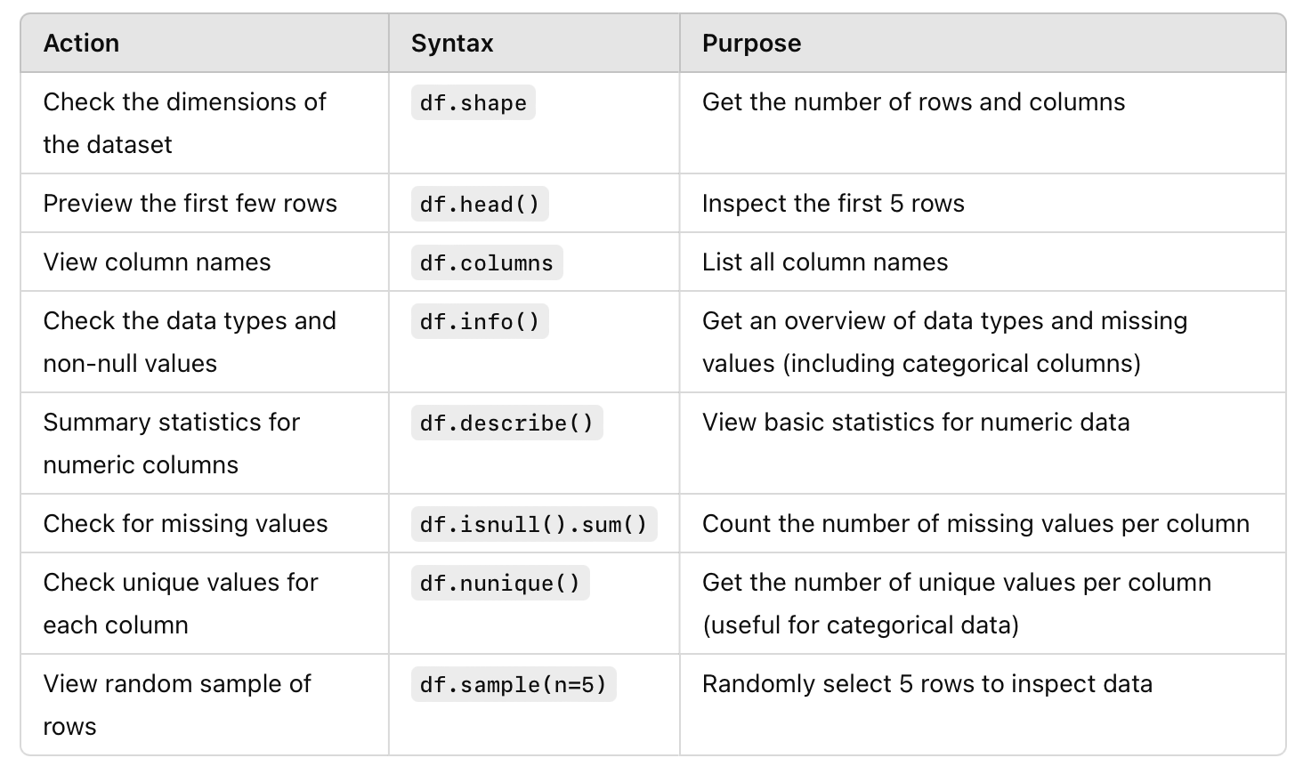
Common Data Overview Syntax

Slide 73
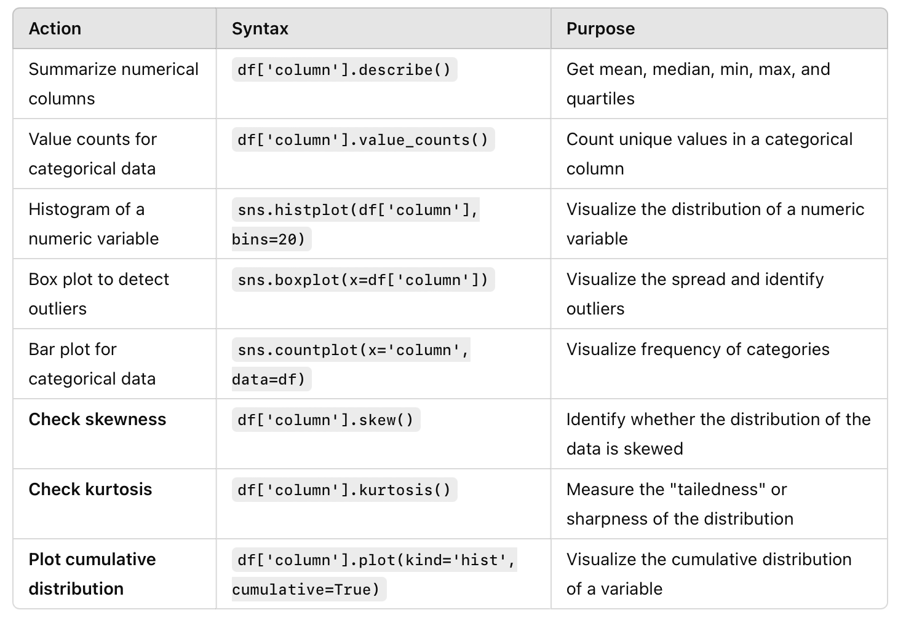
Common Univariate Analysis Syntax

Slide 74
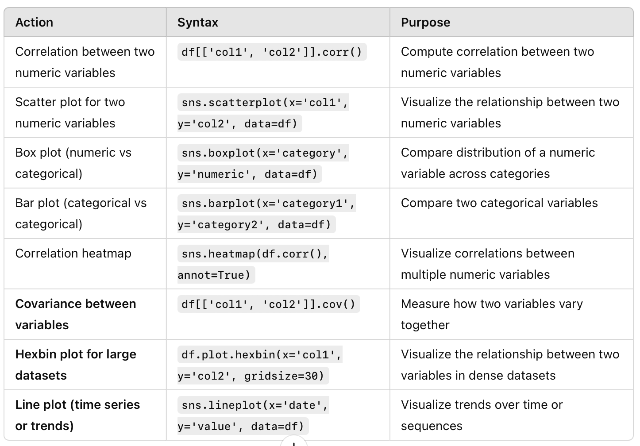
Common Bivariate Analysis Syntax

Slide 75
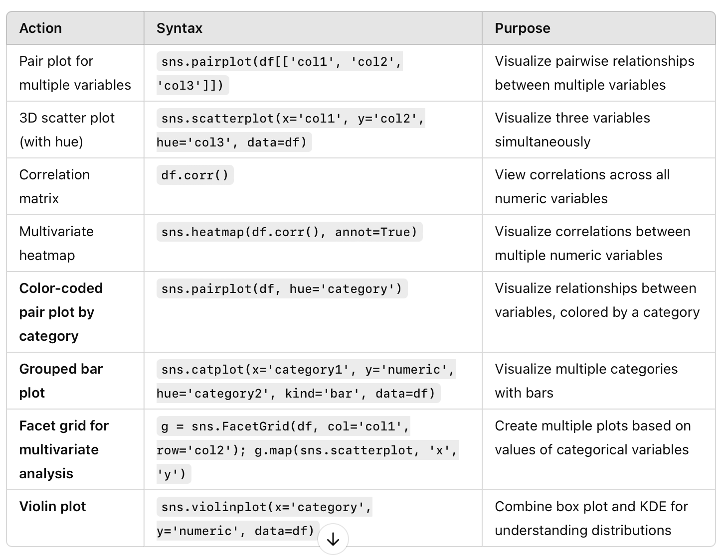
Common Multivariate Analysis Syntax

